Slide 1


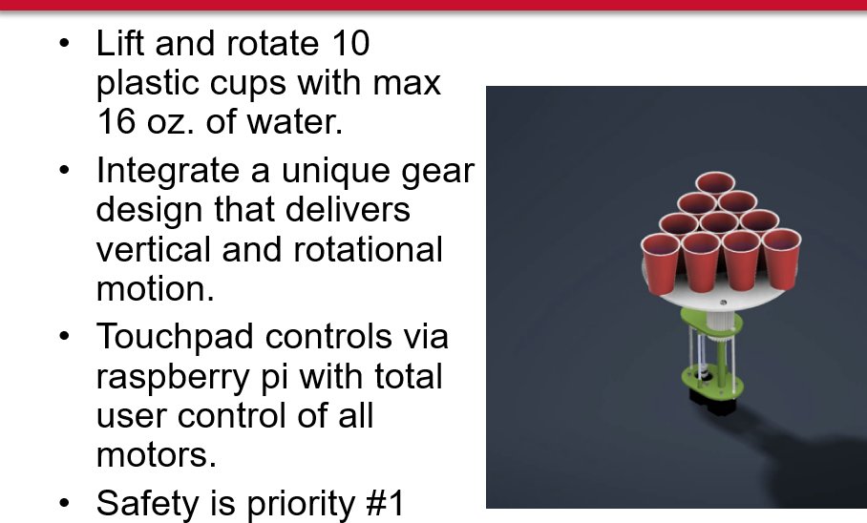
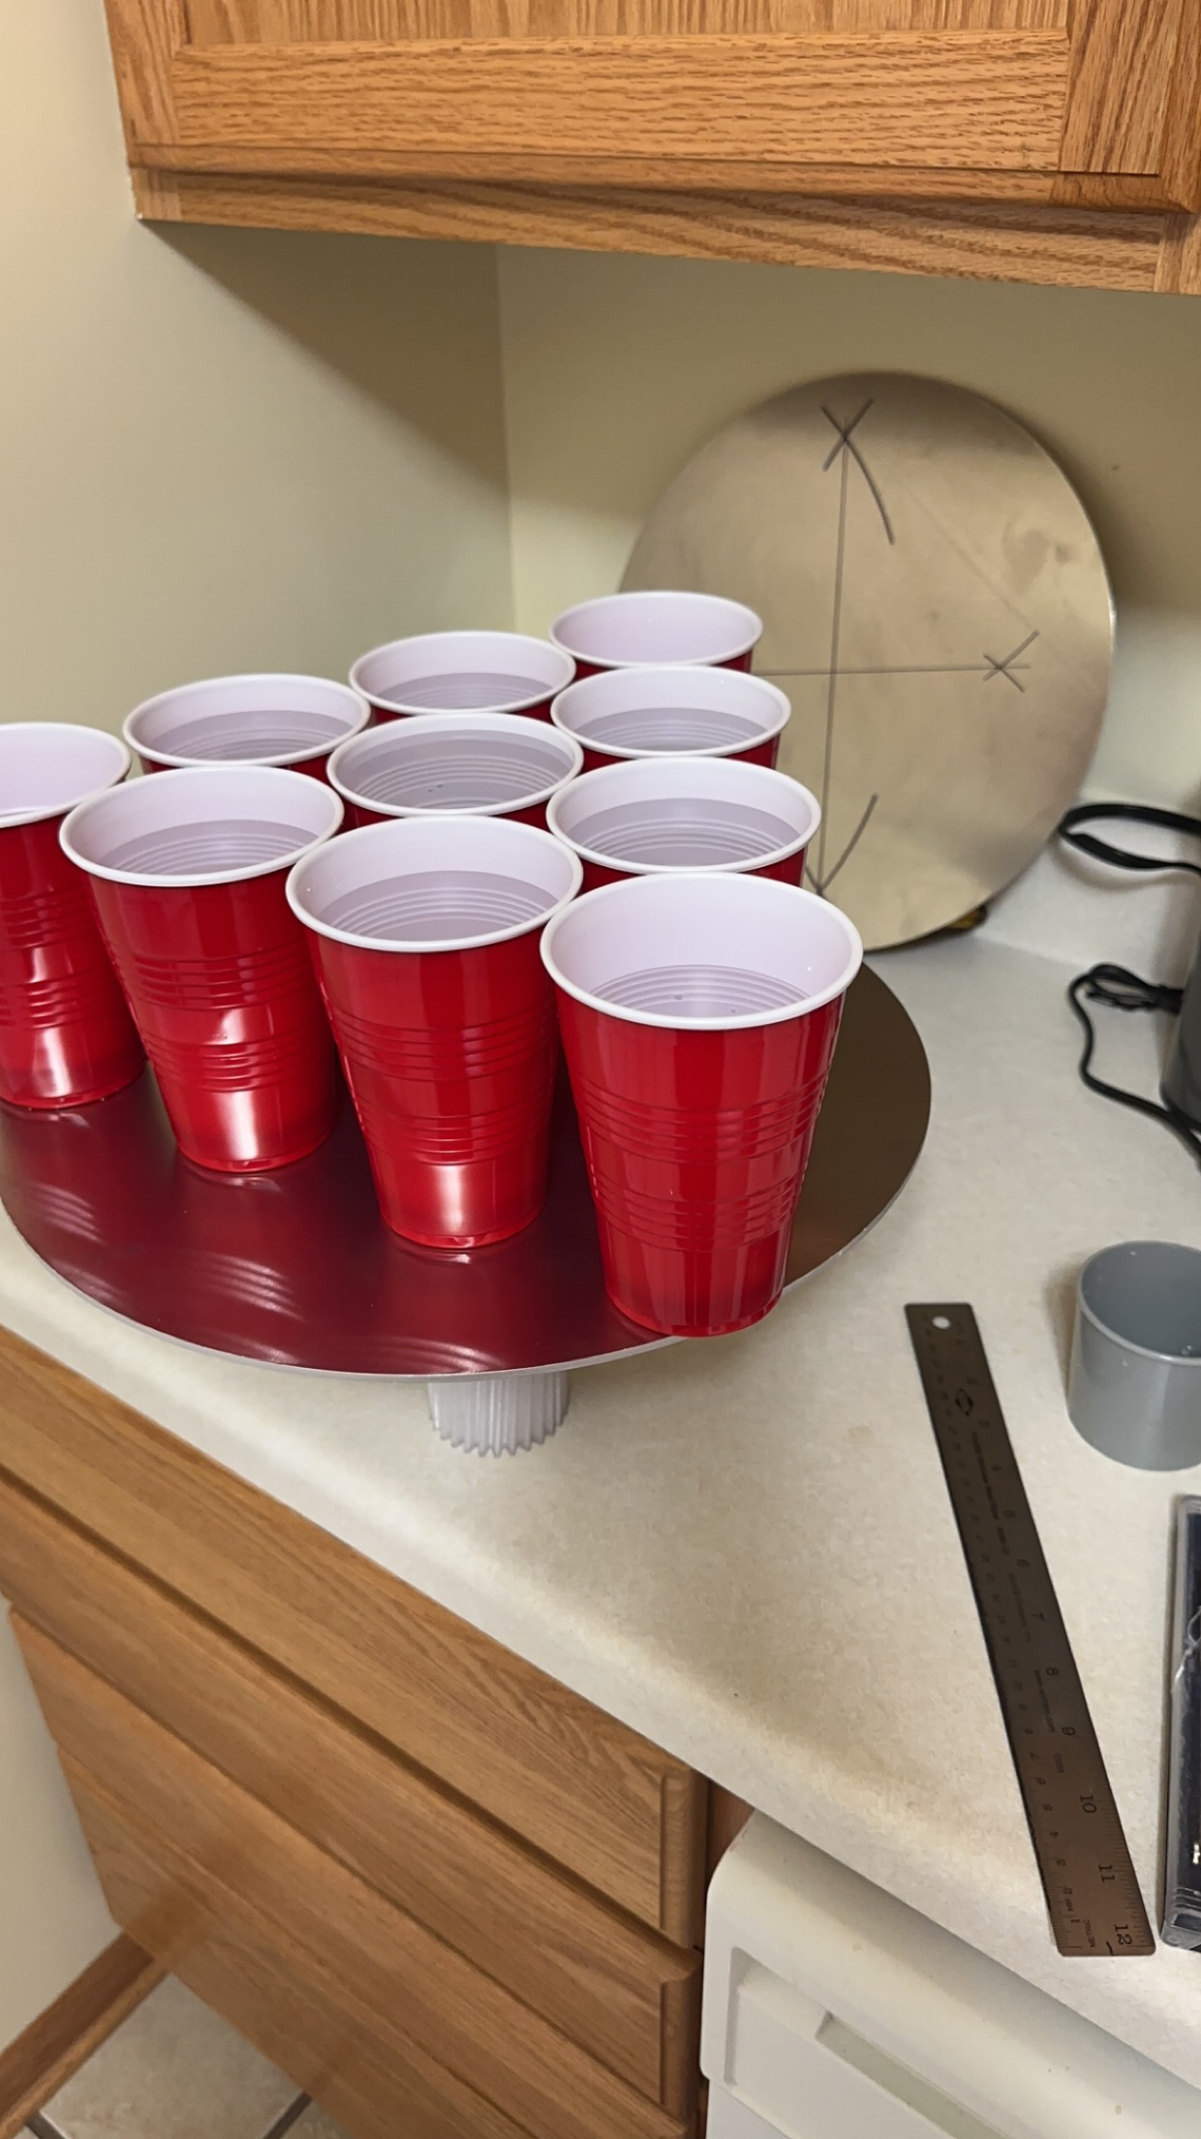
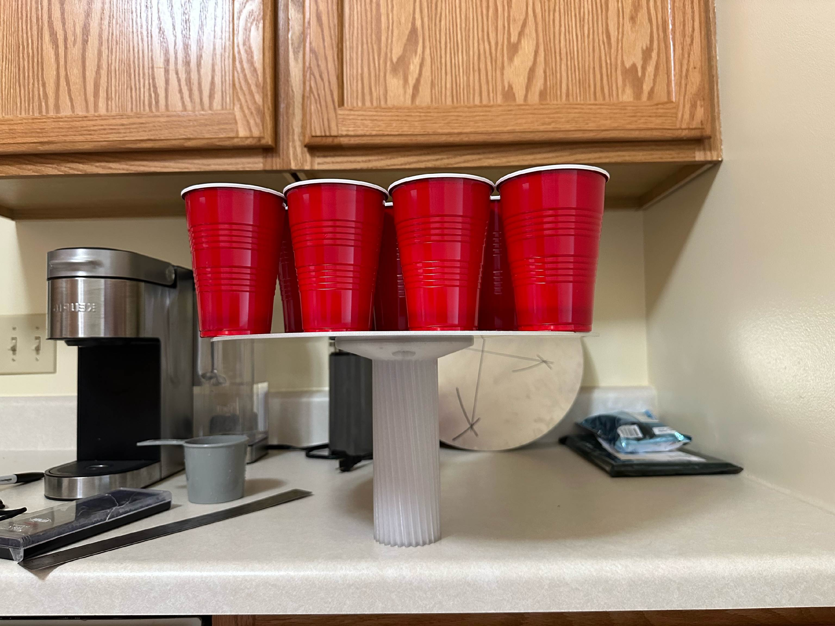
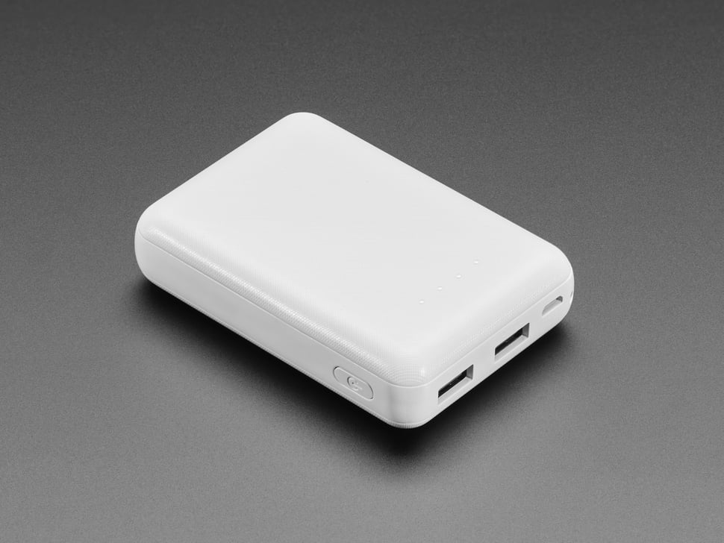
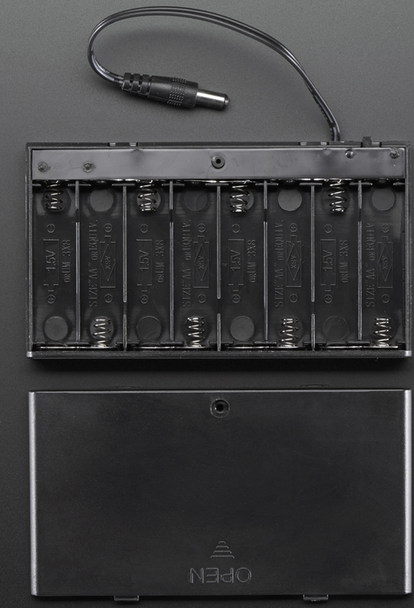
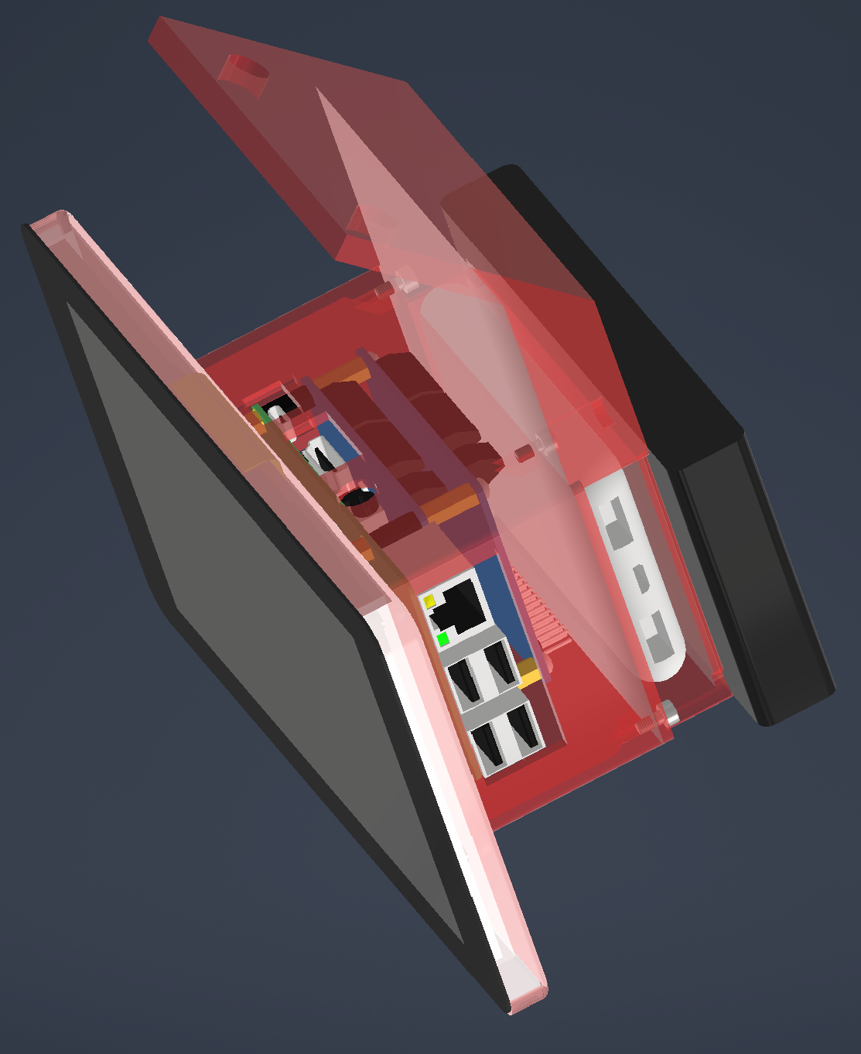
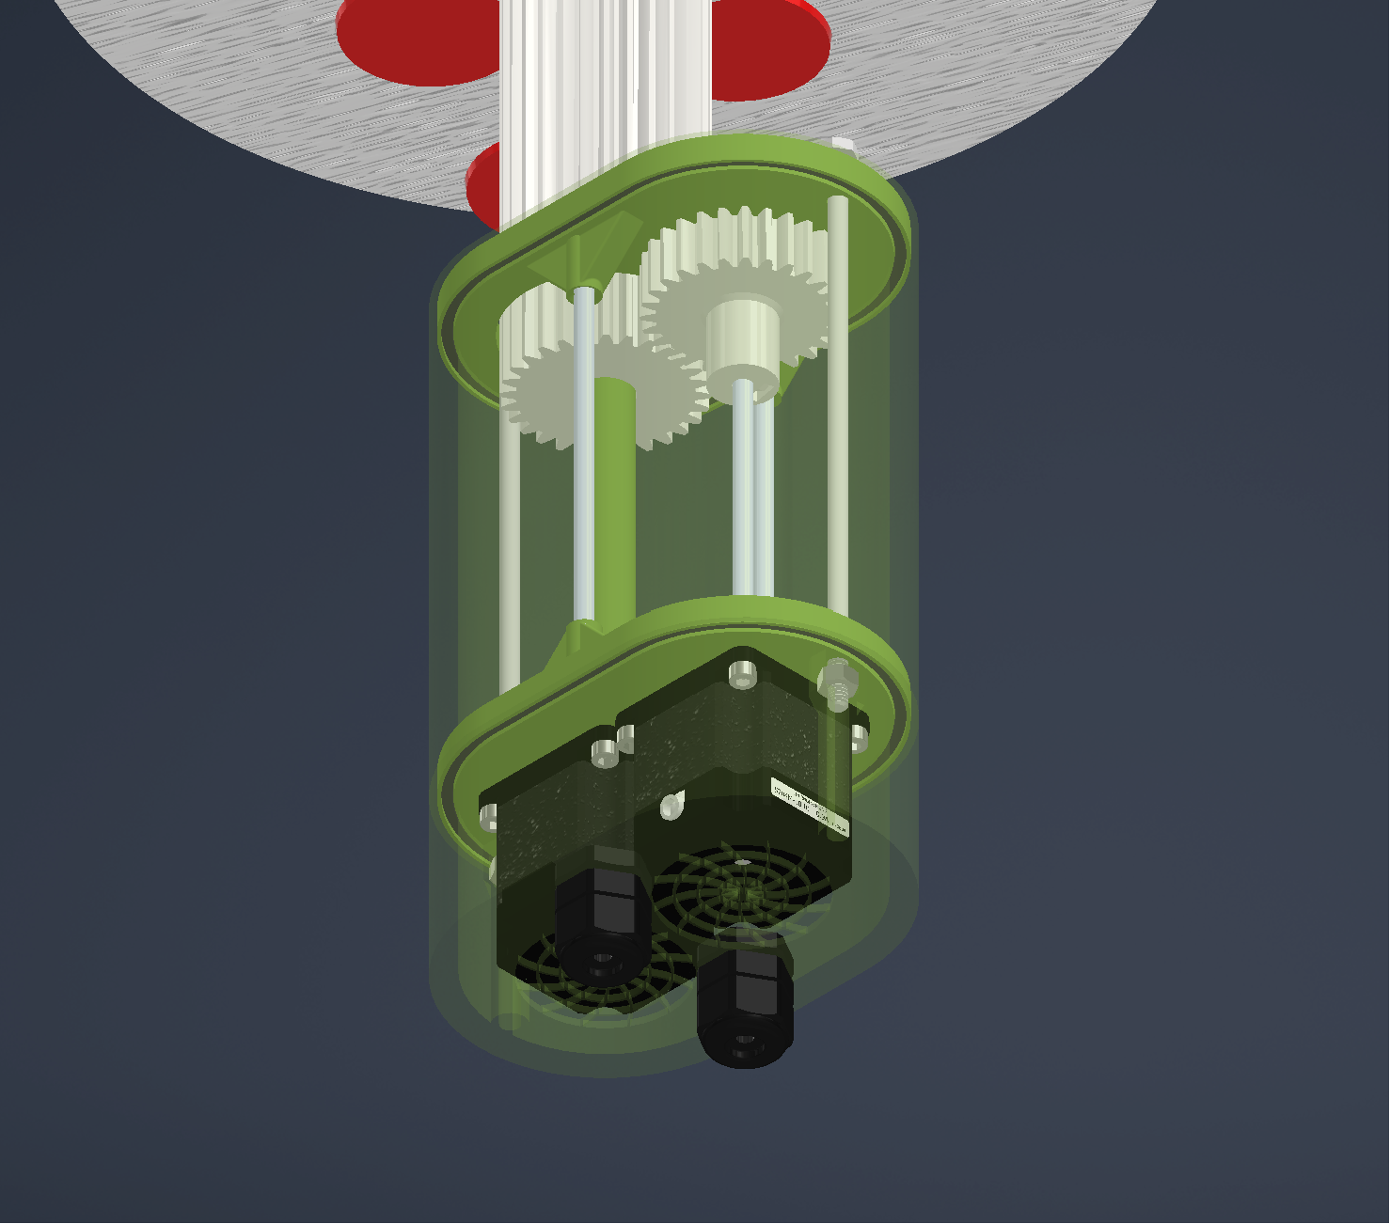
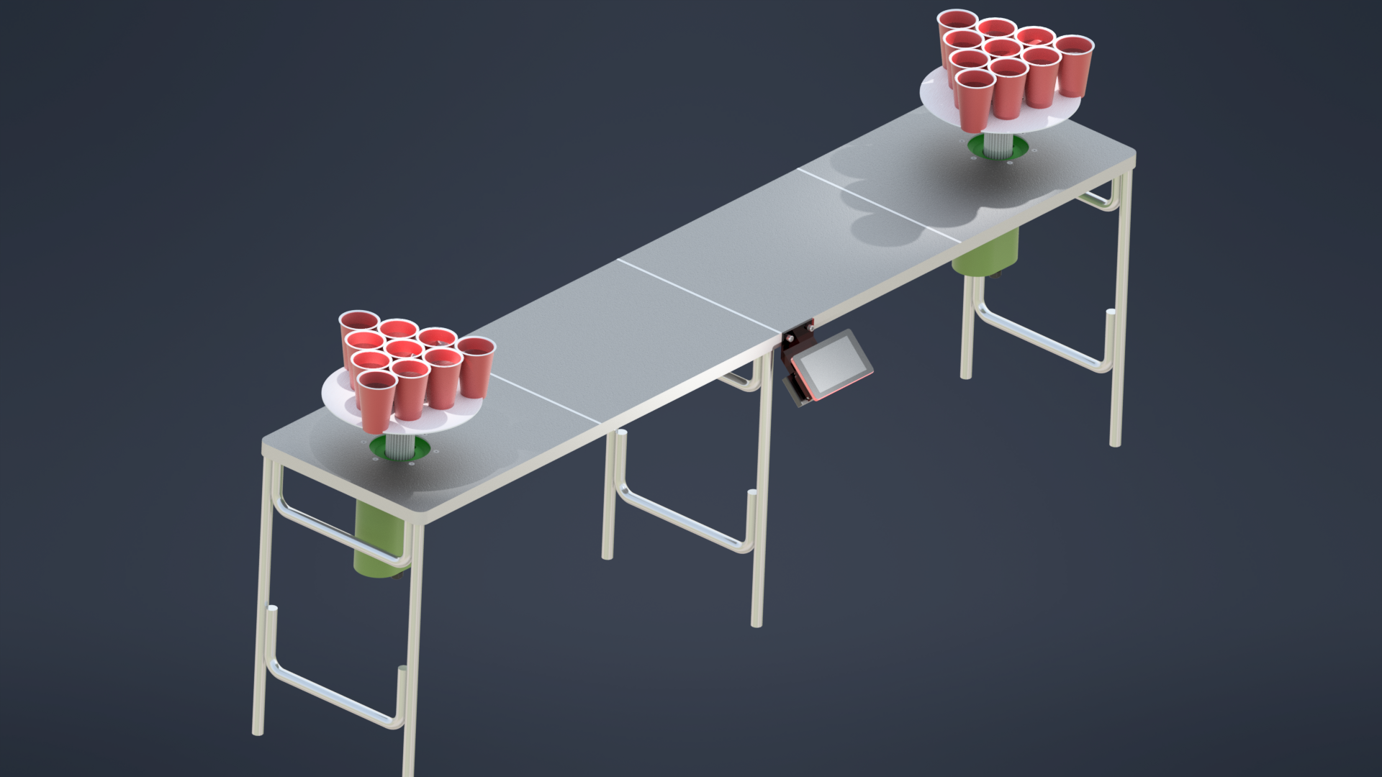
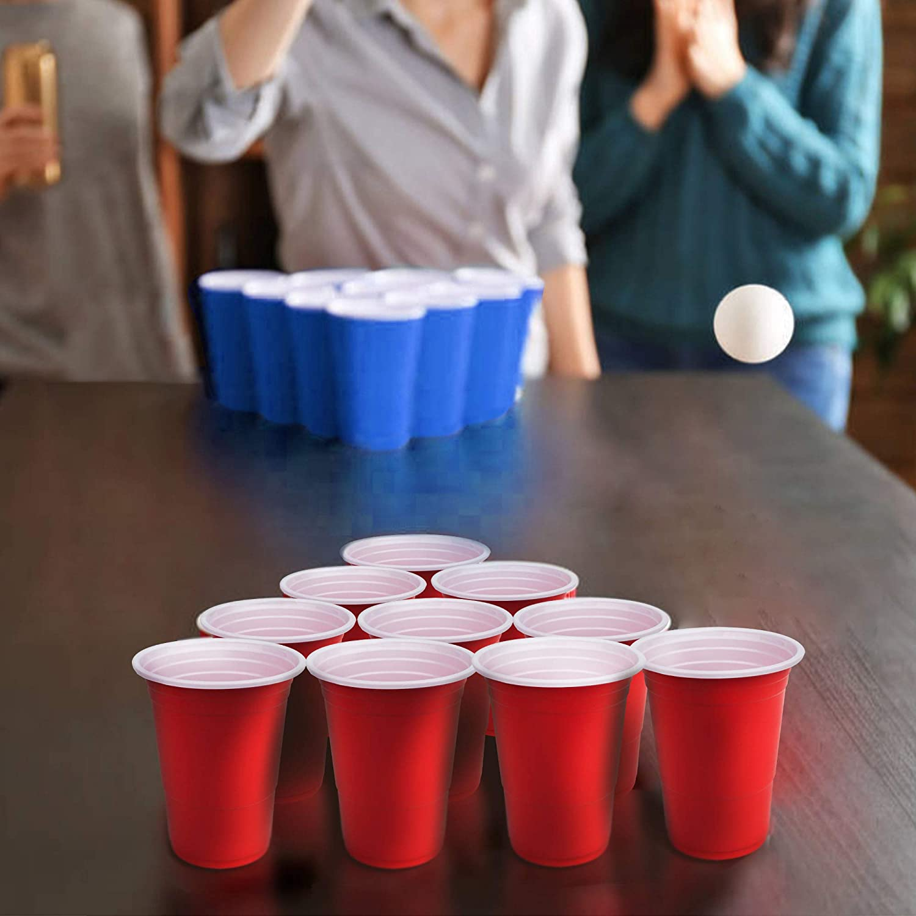
Pong Party Game
Anthony Aughenbaugh
Dr. Otieno
Manufacturing Engineering Technology
Abstract
Methods and Materials
Testing and Design Changes
Three categories of methods/materials:
3D printed custom parts is by far the most common method implemented for this project. PET-G was used to print all the parts on my Prusa MK3S+.
Aluminum Plate was used to make the two plates that hold the cups. They were cut out on the waterjet in the engineering building.
Vendor Items make up the more complex parts, hardware, electronics, etc.
Cup Plate Test
Power
Original design was for two 1/8” Alum plates with a 14” Dia. After testing it was determined that a single plate was more than enough to hold the cups.
Rechargeable Li-Ion Power Bank with 2 x 5V Outputs @ 2.1A - 5000mAh, powers RPI (on the left) and 8 AA Alkaline 1.5V 3000-4000mAh, powers stepper motors (on the right)
Introduction: Pong Party Game
Examples of Proposed Solutions
Conclusions
Raspberry PI Case
O-Rings and Cable Glands
The project was a great start at creating a fun and interactive game that has the potential to bring lots of joy. The python code for the project could use some more ironing out to make a perfect product.
A new twist to a classic party game.
Adding both vertical movement and rotating the cups adds a fun challenge.
Acknowledgements
Dr. Otieno – Advisor
Mike Reynolds – Water jet
Chad Wherli – O-ring documentation
Wherli Custom Fab – Powder Coating
Hangs off table @ 45 deg. Compact design for PI, motor controller, touchscreen, and batteries.
O-Rings to add water resistance around motors. Cable Glands to keep wires from exposed wiring.

